Slide 1
Preventing and addressing violence against women and children: consulting on the next National Plan

Slide 2
Your views will help all Australian governments to reduce violence against women and children by:
building on what is working,
improving collaboration between the Commonwealth and state and territory governments, business and across the community.
About this discussion guide:
This document is a visual aid to support you better in responding to the DSS Engage survey.
Key principles are included to reflect what we have learned so far.

Slide 3
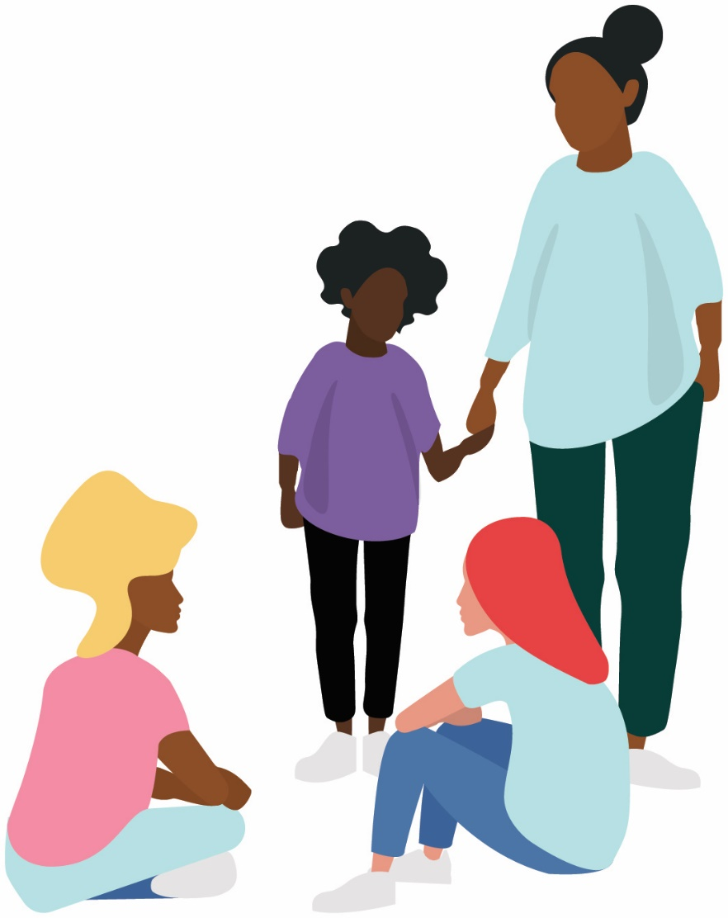
Principles
Everyone has a right to live free from violence, and reducing violence against women and children is everyone’s responsibility.
Aboriginal and Torres Strait Islander people must be at the centre of all aspects of responding to violence in their communities.
Gender inequality is a key driver of violence against women, and reinforced by factors such as socio-economic status, mental illness and prejudice.
Our approach to women and children with diverse lived experiences needs to be inclusive, strengths-based, and promote social cohesion.
Children and young people need responses that are age appropriate and tailored to their needs.
Actions will be based on evidence from lived experience and research relating to violence against women and children.

Slide 4
Since the age of 15, women are more likely to experience intimate partner violence. Around 1 in 6 women experience physical violence by a partner, compared to one in 17 men. Women are eight times more likely to experience sexual violence by a partner than men.
Evidence
According to the ABS Personal Safety Survey (PSS);
Around 15.5% of people (2.9 million) are estimated to have experienced physical or sexual violence from a current or former partner, boyfriend, girlfriend or date since the age of 15.
Women aged 18 years and over were more likely than men to have experienced either physical violence and/or sexual violence by a partner since the age of 15.
Approximately 1 in 4 women (23% or 2.2 million) and 1 in 13 men (7.8% or 703,700) are estimated to have experienced physical or sexual violence from a current or former partner, boyfriend, girlfriend or date
An estimated 17% of women (1.6 million) and 6.1% of men (547,600) had experienced violence by a partner since the age of 15
Around 1 in 6 women (16% or 1.5 million) experience physical violence by a partner, compared to one in 17 men (5.9% or 528,800)
Around 11.7 % of people are estimated to have experienced sexual violence since the age of 15
Around 19.5% of people are estimated to have experienced emotional abuse by a current or previous partner since the age of 15
Approximately 1 in 5 women (18.4% or 1.7 million) and 1 in 20 men (4.7% or 428,800) are estimated to have experienced sexual violence since the age of 15.
8x
Women were eight times more likely to experience sexual violence by a partner than men. Approximately 5.1% of women (480,200) experienced sexual violence by a partner compared with approximately 0.6% of men (53,000)
Around 1 in 4 women (23 % or 2.2 million) and 1 in 6 men (15.9% or 1.4 million) had experienced emotional abuse by a current or previous partner.
Notes:
ABS. PSS. 2016. Go to: https://www.abs.gov.au/statistics/people/crime-and-justice/personal-safety-australia/latest-release

Slide 5
Evidence
INDIGENOUS AUSTRALIANS Indigenous adults are 34 times as likely to be hospitalised for family violence as non-Indigenous adults.
CHILDREN In 2017–18, 22% (26,500) clients seeking specialist homelessness services as a result of family or domestic violence were aged 0–9 (AIHW 2019). For both women and men, experiencing abuse before the age of 15 increased their likelihood of experiencing intimate partner violence as an adult by threefold.
PEOPLE WITH DISABILITY People with disability were 1.8 times as likely to have experienced physical and/or sexual violence from a partner in the previous year, compared with people without disability.
PEOPLE IN RURAL AND REMOTE AUSTRALIA People in remote and very remote Australia are more than 24 times as likely to be hospitalised for domestic violence as are people in major cities.
PEOPLE FROM CULTURALLY AND LINGUISTIALLY DIVERSE BACKGROUNDS Between March 2013 and June 2016, the Australian Federal Police received 116 case referrals for forced marriage involving young females.
PEOPLE FROM SOCIOECONOMICALLY DISADVANTAGED AREAS People living in the most disadvantaged areas of Australia are 1.5 times as likely to experience partner violence as those living in areas of least disadvantage.
LGBTIQA+ In the last 5 years, workplace sexual harassment was higher among those identifying with diverse sexual orientation (52%) than among those identifying as heterosexual (31%).
Notes:
AIHW. 2019. Family, domestic and sexual violence in Australia: continuing the national story 2019. Go to: https://www.aihw.gov.au/reports/domestic-violence/family-domestic-sexual-violence-australia-2019/contents/summary

Slide 6
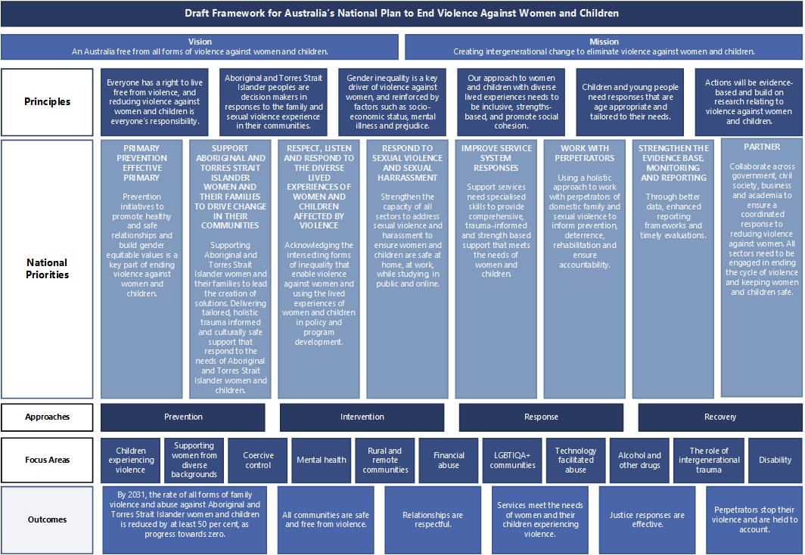

Slide 7
What do we want to achieve?
All communities are safe and free from gender-based violence
By 2031, the rate of all forms of family violence and abuse against Aboriginal and Torres Strait Islander women and children is reduced by at least 50 per cent, as progress towards zero
Perpetrators stop their violence and are held to account
Justice responses are effective
Services meet the needs of those experiencing violence
Relationships are respectful and gender equality is reinforced
Vision:
An Australia free from all forms of gender-based violence
Mission:
Creating intergenerational change to eliminate violence against women and children in Australia

Slide 8
Areas of focus:
Primary Prevention.
Aboriginal and Torres Strait Islander Women and Children.
Respect, listen and respond to the diverse lived experiences of women and children affected by violence.
Respond to sexual violence.
Improve service system responses.
Work with perpetrators.
Partner with all governments and settings.
To reduce gender-based violence, we need a new National Plan which responds to need and is coordinated, based on evidence and agile enough to meet new and emerging challenges.

Slide 9
Many factors can affect the impacts of violence on those experiencing it
Diverse life experiences
Disability
Women from diverse backgrounds
Sexuality and gender identity
Children and young people
Race
Migration and visa status
Forms of violence
Technology facilitated abuse
Coercive control
Financial abuse
Sexual violence
Physical violence
Sexual harassment
Emotional abuse
Stalking
Social, psychosocial and environment factors
Chronic health conditions
Geographical location
Alcohol & other drugs
Intergenerational trauma
Ableism
Racism
Religion
Homophobia
Mental health

Slide 10
Your feedback will form part of targeted consultation activities:
Advisory Group
Virtual Workshop
DSS Engage
A National Summit
Accessible online feedback from interested parties including people experiencing violence and those supporting them as well as the general public.
A National Plan Advisory Group with experts on family, domestic and sexual violence.
To explore several focus areas:
Primary prevention, including issues of gender and other exacerbating factors
Men in different capacities including role models and perpetrators
Non-physical forms of abuse
Effectiveness of services
Sexual violence
Responding to diverse experiences
Aboriginal and Torres Strait Islander communities
Women and children with disability
National Summit to bring together key experts in a national conversation on the priorities and action required to prevent and respond to violence against women.
As well as consultations, the next National Plan will be informed by many other avenues, including previous evaluations, current evidence, the Wiyi Yani U Thangani (Women's Voices) project and findings from the House Standing Committee Inquiry into family, domestic and sexual violence.

Slide 11
You can subscribe to updates on the feedback received during the consultation via DSS Engage and plan4womenssafety.dss.gov.au.

