Slide 1
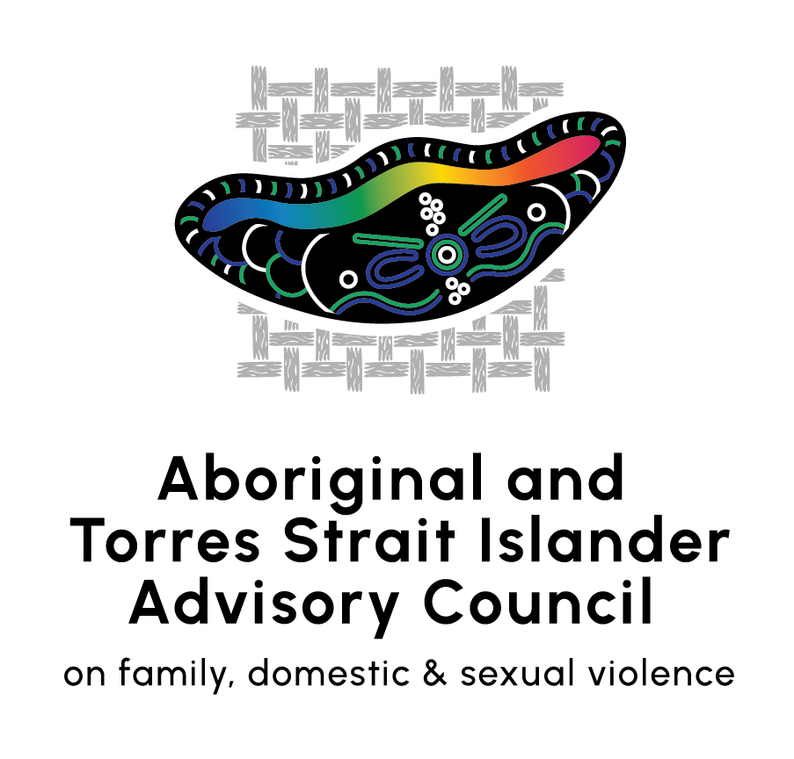
Aboriginal and Torres Strait Islander Action Plan
National Plan to End Violence against Women and Children 2022-2032
About this consultation guide:
This document is a visual aid to support you to respond to the DSS Engage survey.
Consultation guide: Informing the development of the Aboriginal and Torres Strait Islander Action Plan

Slide 2
By participating in this consultation, your views will help all Australian governments to address the unacceptable rates of violence against Aboriginal and Torres Strait Islander women and children by:
building our understanding of violence against Aboriginal and Torres Strait Islander women and children
providing insights into the experiences and safety needs of Aboriginal and Torres Strait Islander families and communities
informing the development of community-led and healing-informed solutions
improving collaboration between Australian, state and territory governments and the Aboriginal community-controlled sector.
Consultation guide: Informing the development of the Aboriginal and Torres Strait Islander Action Plan

Slide 3
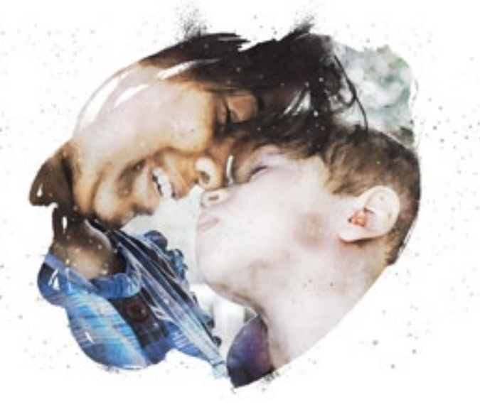
What do we want to achieve?
All Aboriginal and Torres Strait Islander women, children, families and communities are safe and free from family, domestic and sexual violence
Closing the Gap
Target 13:
By 2031, the rate of all forms of family violence and abuse against Aboriginal and Torres Strait Islander women and children is reduced at least by 50%, as progress towards zero
Build capacity of both the indigenous community-controlled and non-indigenous wellbeing workforces.
Relationships are respectful and gender equality is reinforced
Vision:
Our people, no matter where they live, work and play are culturally safe and strong, and live free from violence.
Consultation guide: Informing the development of the Aboriginal and Torres Strait Islander Action Plan

Slide 4
Development of the dedicated Aboriginal and Torres Strait Islander Action Plan
For the first time, the National Plan to End Violence against Women and Children 2022-2032 will be supported by a dedicated Aboriginal and Torres Strait Islander Action Plan. This will ensure approaches to ending violence against Aboriginal and Torres Strait Islander women and children are:
The Aboriginal and Torres Strait Islander Advisory Council on family, domestic and sexual violence is leading the development of the dedicated Aboriginal and Torres Strait Islander Action Plan in partnership with Government.
Community-led
Culturally-safe
Strengths-based
Healing-informed
The Action Plan will include:
actions for immediate implementation targeted towards addressing the safety needs of Aboriginal and Torres Strait Islander families and communities
longer-term actions to address the complex, sensitive and structural factors driving violence against Aboriginal and Torres Strait Islander families and communities
recommendations to Commonwealth, state and territory government for policy legislative reform to drive structural change.
Consultation guide: Informing the development of the Aboriginal and Torres Strait Islander Action Plan

Slide 5
Aboriginal and Torres Strait Islander Action Plan Framework
Vision : Our people no matter where they live, are culturally safe and strong, and live free from violence.
Voice, self-determination, agency
Shared decision-making in genuine partnership with government. Community-led solutions. Aboriginal and Torres Strait Islander women and children are front and centre of the design and delivery.
Strength, resilience, therapeutic healing
Solutions are trauma-aware, healing-focused, culturally safe and kinship centred.
Cultural responses are used to address harmful behaviours. Health and wellbeing is prioritised.
Reforming institutions and systems
Responses to systemic biases and structural racism are embedded across family violence service system. Build capacity in the workforce and recognise the need for legislative reform.
Inclusion and intersectionality
Diverse experiences are acknowledged including women, girls, men, boys, Elders, Stolen Generations, people living remotely, people with disability, and LGBTIQA+, Sistergirl, Brotherboy communities.
Evidence and data
eco-systems -
Understanding our stories
A local, culturally-informed data and evidence eco-system is created and managed by Aboriginal and Torres Strait Islander peoples.
REFORM AREAS
Addressing immediate safety needs
Laying strong foundations for long-term change
Justice and equitable outcomes
Uphold human rights and enhance understanding of legal rights, including access to legal assistance.
Investment in strengthening positive change/leadership/cultural connection programs.
Funding and investment
Build knowledge of expenditure across governments and reform relevant key components to align with Closing the Gap. Create opportunities for shared decision-making around funding allocations, including for housing.
Building the data and evidence base
Create a data and evidence eco-system specific to Target 13.
Build Indigenous research capacity through practical measures.
Local, culturally-informed evidence is collected and used to develop solutions. Local stories are understood. Governments and mainstream agencies at all levels share data to enable community-controlled organisations to make data-informed decisions.
OUTCOMES
Sector capacity building
Building the capacity of the Aboriginal and Torres Strait Islander community-controlled sector and workforces, with targeted focus on the needs of all groups in community.
Leadership and governance
Establish an Aboriginal and Torres Strait Islander family violence peak body to oversee implementation of the Action Plan and Target 13 of the National Agreement on Closing the Gap.
Establish an Aboriginal and Torres Strait Islander Commissioner for family safety with suitable powers pursuant to legislation and administration.
Target 13 of the National Agreement on Closing the Gap: By 2031, the rate of all forms of family violence and abuse against Aboriginal and Torres Strait Islander women and children is reduced at least by 50%, as progress towards zero.

Slide 6
Embedding Target 13 of the National Agreement on Closing the Gap
In alignment with the National Agreement on Closing the Gap, the Action Plan will support measures designed to achieve Target 13:
By 2031, the rate of all forms of family violence and abuse against Aboriginal and Torres Strait Islander women and children is reduced at least by 50%, as progress towards zero.
Examples of ways the Action Plan could give effect to this include:
Aboriginal Community Controlled Organisations delivering services to their communities
prevention-focused services that support and strengthen families
trauma-informed responses for children impacted by violence
People experiencing violence have access to therapeutic healing, including mothers and children
working with men to provide cultural healing and alternative pathways to criminal justice responses
specialist programs and services are designed with, by and for Aboriginal and Torres Strait Islander peoples
developing and prioritising opportunities for the Aboriginal and Torres Strait Islander workforce
organisations, businesses, and governments collaborating with Aboriginal and Torres Strait Islander peoples and communities to deliver localised best-practice responses
ensuring Aboriginal and Torres Strait Islander communities retain ownership of their cultural knowledge and intellectual property and integrating mechanisms to promote data sovereignty.
Consultation guide: Informing the development of the Aboriginal and Torres Strait Islander Action Plan

Slide 7
Evidence
Deaths from family violence
104 Aboriginal and Torres Strait Islander women aged 18 years and over were victims of domestic homicide between 2009–10 and 2019-20.¹
Aboriginal and Torres Strait Islander women are nearly 11 times more likely to die due to assault than non-Indigenous women.²
Hospitalisations from family violence
3 in 4 hospitalised assaults of Aboriginal and Torres Strait Islander peoples are a result of family violence.³
Aboriginal and Torres Strait Islander women aged over 15 are 34 times more likely to be hospitalised as a result of family violence than non-Indigenous women, with the figure even higher in remote areas of Australia.⁴
Aboriginal and Torres Strait Islander children are impacted both directly and indirectly by family, domestic and sexual violence, which contributes to the over- representation of Aboriginal and Torres Strait children in Australia’s child protection systems.⁵
In 2017–18, 16% of Aboriginal and Torres Strait children received child protection services.⁶
Aboriginal and Torres Strait Islander men also experience extremely high rates of violence, as both children and adults.
Between 2014–15 and 2015–16 there were 18 Indigenous male victims of domestic homicide, with 3 Indigenous men killed by an intimate partner.⁷
Aboriginal and Torres Strait Islander men are more likely to be hospitalised or killed due to assault from another family member than non-indigenous men.⁸
Disability
More than half of Aboriginal and Torres Strait peoples who experience family violence have disability.⁹
Other forms of gender-based violence
One in 4 Aboriginal and Torres Strait Islander peoples have had their intimate image/s or video/s shared online without their consent.¹¹
More than half of Aboriginal and Torres Strait Islander workers have experienced workplace sexual harassment.¹²
Sexual violence
Aboriginal and Torres Strait Islander women report 3 times as many incidents of sexual violence.¹⁰
Notes:
ABS. PSS. 2016. Go to: https://www.abs.gov.au/statistics/people/crime-and-justice/personal-safety-australia/latest-release

Slide 8
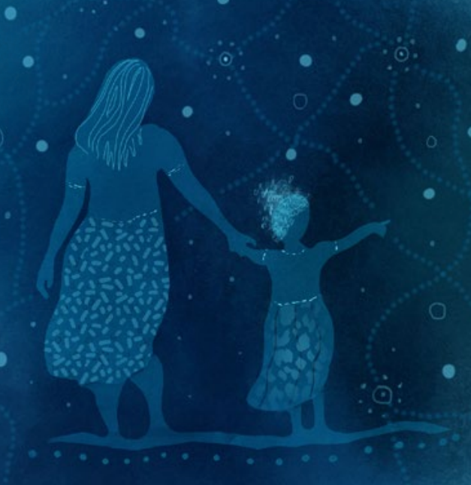
Aboriginal and Torres Strait Islander-led research
The Family and Community Safety Study for Aboriginal and Torres Strait Islander Peoples (FaCtS study) found that community members overwhelmingly described family and community violence in relation to its historical context.
They viewed contemporary violence as stemming from colonisation and the related violence enacted on Aboriginal and Torres Strait Islander peoples and communities, perpetuated by intergenerational trauma and the undermining of traditional gender structures. Individuals and communities have experienced severe and widespread trauma across generations, with limited capacity to address it (p.15, FaCtS study).
Participants spoke of the need to heal families, through redressing the breakdown in kinship and family structures. Those experiencing violence wanted the violence to stop and family disruption to be minimised (p.15, FaCtS study).
The Wiyi Yani U Thangani (Women’s Voices) Report emphasises the importance of self‑determined and First Nations women-led responses to achieve systemic change.
“Aboriginal and Torres Strait Islander women are calling for all Australian governments to significantly refocus and invest in early intervention and prevention supports. They want a system grounded in their self-determination and underpinned by healing and restorative approaches, aimed at supporting individuals and families, while also improving the conditions, and transforming the context, in which people live” (p.101, Wiyi Yani U Thangani).

Slide 9
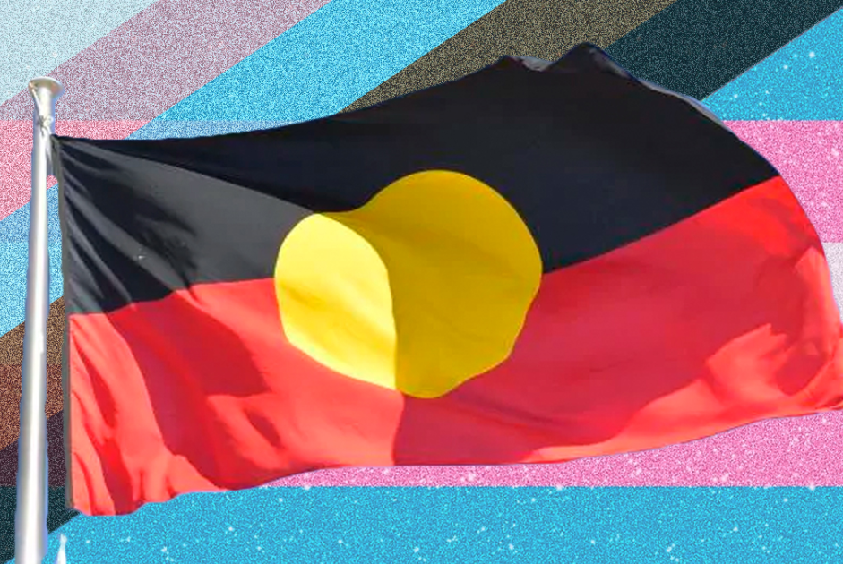
Inclusion and intersectionality
The Aboriginal and Torres Strait Islander Action Plan will acknowledge the diverse experiences of individuals, families and communities experiencing violence and will address the needs of all Aboriginal and Torres Strait Islander peoples.
This includes:
women
girls
men
boys
Elders
Stolen Generations
people living remotely
people with disability
LGBTIQA+, Sistergirl and Brotherboy communities.
Violence experienced by LGBTIQA+ people can also be gender-based violence and it shares many of the same drivers of violence against women.
Aboriginal and Torres Strait Islander peoples who are gender diverse might use the terms Sistergirl and Brotherboy.
Brotherboy and Sistergirl communities experience a number of significant and intersecting points of discrimination and marginalisation. It is important that actions to prevent and respond to gender-based violence include actions to address violence against Brotherboy and Sistergirl communities and that those actions are culturally responsive and tailored to their needs.
Consultation guide: Informing the development of the Aboriginal and Torres Strait Islander Action Plan
Notes:
AIHW. 2019. Family, domestic and sexual violence in Australia: continuing the national story 2019. Go to: https://www.aihw.gov.au/reports/domestic-violence/family-domestic-sexual-violence-australia-2019/contents/summary

Slide 10
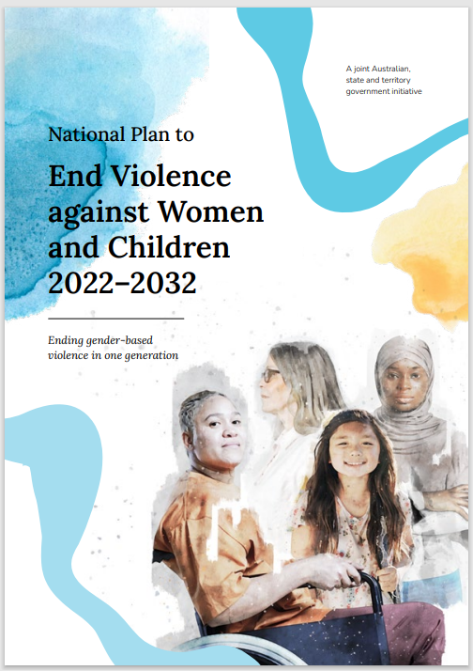
National Plan to End Violence against Women and Children 2022-2032
On 17 October 2022, the Australian, state and territory governments released the National Plan to End Violence against Women and Children 2022–2032 (National Plan).
The National Plan is the overarching national policy framework that will guide actions towards ending violence against all women and children in Australia over the next 10 years.
The voices of Aboriginal and Torres Strait Islander peoples have been crucial in informing the development of this National Plan.
The National Plan embeds the National Agreement on Closing the Gap as one of its cross-cutting principles.
It acknowledges the connections between, and impact of, social and economic disadvantage as a result of intergenerational and ongoing experiences of trauma, including racism, dispossession and violence.
Consultation guide: Informing the development of the Aboriginal and Torres Strait Islander Action Plan

Slide 11
National Plan priority areas for action
Funding models: For regional, rural and remote communities, funding models need to address the complexity of service delivery, workforce challenges and access issues on a community-by-community basis.
Community led-solutions: Aboriginal and Torres Strait Islander organisations delivering family, domestic and sexual violence services, healing, men and boys services and recovery services to their communities.
A focus on prevention: Establishing prevention-focused services that support and strengthen families, and recognising trauma-informed responses for children impacted by violence.
Healing: Addressing intergenerational trauma for Aboriginal and Torres Strait Islander peoples by truth-telling and capacity building, as well as by strengthening connections to culture, language, knowledge and identity.
Policing: Implementing culturally-safe and effective policing and justice responses for Aboriginal and Torres Strait Islander peoples, and prevent all cases where Aboriginal women experiencing family violence are misidentified as the perpetrator.
Data sovereignty : Ensuring Aboriginal and Torres Strait Islander communities retain ownership of their cultural knowledge and intellectual property, and integrating mechanisms to promote data sovereignty.
Justice: Engaging Aboriginal and Torres Strait Islander men and boys outside the criminal justice system through cultural healing led by Aboriginal and Torres Strait Islander community leaders, Elders and organisations.

Slide 12
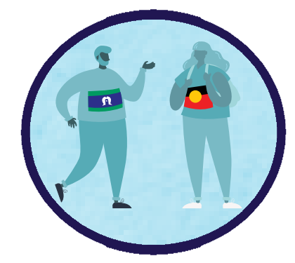
Your feedback will form part of broader consultation activities:
Advisory Council
Face-to-face meetings
Online surveys
Coalition of peaks networks
Accessible online feedback from interested parties including people experiencing violence and those supporting them as well as the general public.
The Aboriginal and Torres Strait Islander Advisory Council will undertake face-to-face consultation engagements in every state and territory
To explore several focus areas:
Drivers and reinforcing factors
Healing from trauma
Improving justice responses
Community controlled solutions
Primary prevention
Working with men and boys
Inclusive responses
The needs of children
Reaching individuals and organisations through established networks including the Coalition of Peaks and ORIC to seek views and input.
As well as consultations, development of the Action Plan will be informed by other avenues, including existing evidence and frameworks, particularly Aboriginal and Torres Strait Islander-led research, the Wiyi Yani U Thangani report and findings from the Monash University stakeholder consultation report.

Slide 13
References
Australian Institute of Criminology, National Homicide Monitoring Program, 1989–90 to 2019–20.
Al-Yaman, F., Van Doeland, M., & Wallis, M. (2006). Family violence among Aboriginal and Torres Strait Islander peoples. Canberra: Australian Institute of Health and Welfare.
AIHW, Family, domestic and sexual violence in Australia: Continuing the national story 2019 (aihw.gov.au), Australian Government, 2019
AIHW, Continuing the national story
Secretariat of National Voice for our Children (SNAICC), National Family Violence Prevention Legal Services Forum (NFVPLS) & National Aboriginal and Torres Strait Islander Legal Services (NATSILS) 2017. Strong_Families_Safe_Kids-Sep_2017.pdf (snaicc.org.au)
AIHW, Continuing the national story
AIHW, Continuing the national story
AIHW, Continuing the national story
AIHW, Continuing the national story
A Olsen and R Lovett, Existing knowledge, practice and responses to violence against women in Australian Indigenous communities: State of knowledge paper, ANROWS Landscapes, ANROWS, 2016
Australian Human Rights Commission, Respect@Work: National Inquiry into Sexual Harassment in Australian Workplaces, 2020.
Australian Human Rights Commission, Respect@Work
Consultation guide: Informing the development of the Aboriginal and Torres Strait Islander Action Plan

