Slide 1


NDIS Review

Slide 2

We were committed to making sure we heard from as many people as possible
3,976 submissions
287 public engagements
More than 10,000 people
Stage One
What are the problems?
Stage Two
What are the solutions?

Slide 3
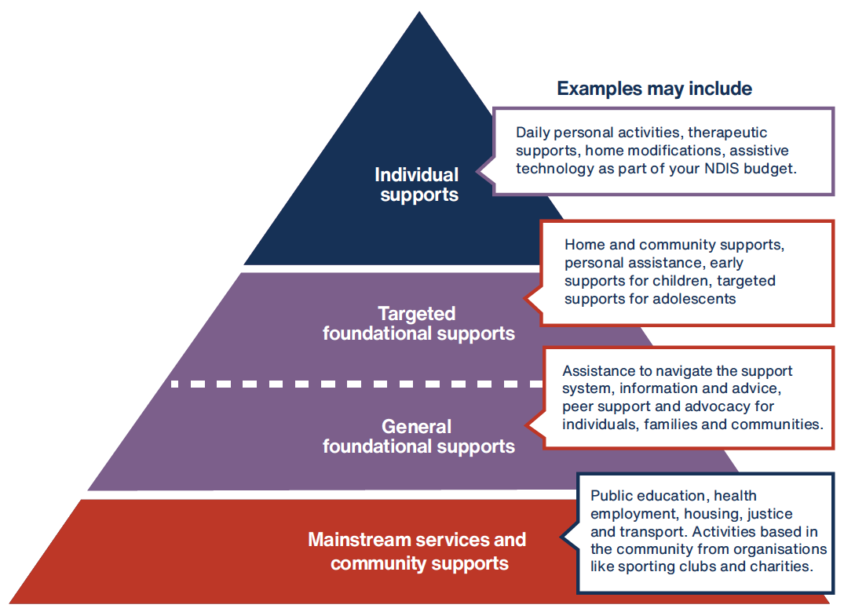
There is not enough support outside the NDIS. There are gaps and people are missing out.
Solution:
The entire disability system should be planned, organised and connected.
A connected system

Slide 4
Main areas of reform
A connected system
Access
and budgets
Children and
families
Psychosocial disability
Housing and
living
Navigation
Quality services

Slide 5

Access and budgets
Access
and budgets
The current system is too complicated and doesn’t focus on the support you need in your daily life.
Solution
Support from day one
Linked to foundational supports
Simpler application process
Assessment of needs to set the flexible budget
Longer-term plans

Slide 6

Navigation
Navigation
People with disability are expected to work through complex government systems all on their own.
Solution
A team of experts who can help you through the system
General navigators
Specialist navigators
Psycho-social navigators
Housing and living navigators
Lead practitioners for children and families

Slide 7

Children and families
Children and
families
There is not enough support where children live, play and learn.
Solution
More support early
More inclusive and accessible mainstream services
Support for families
from a lead practitioner
Specialised early intervention pathway for children with high support needs

Slide 8
Housing and living
Housing and
living
People don’t have real choices about where they live, who they live with and who supports them.
Solution
More housing options
Shared supports for most people - 1:3 ratio
Support from a trained housing and living navigator
Separation of housing and living supports

Slide 9
Psychosocial disability
Psychosocial disability
The scheme does not work well for people with psychosocial disability.
It does not deal well
with episodic needs
or focus enough on personal recovery.
Solution
Better support outside the scheme – including coordination with mental health system
New early intervention pathway focused on recovery
More specialised navigation support

Slide 10
Quality services
Quality services
NDIS markets aren’t working – there are problems with supply and quality.
There are also issues with the integrity of the system – overcharging, overservicing and fraud.
Solution
Proportionate provider registration
Central online platform to find providers
Navigator to help you find services
Electronic payment system
Expanded role for Quality and Safeguards Commission

Slide 11
Questions

Slide 12
What’s next?
We need to reform over time
– so everyone
is ready
The changes need to be done in partnership
with people with disability, their families
with organisations that provide services
with state and territories
Together we can build a world-class system of disability support

Slide 13


Thank you

