Slide 1
Disability Employment Reform
Presenter: Kellie Spence
Position: Group Manager, Disability Employment

Slide 2
Acknowledgement of Country
The Department of Social Services acknowledges the traditional custodians of the land on which we meet today and their connections to land, water, culture and community. We pay our respects to the elders past and present and extend that respect to all Aboriginal and Torres Strait Islander peoples today.

Slide 3
Probity Statement
The Department of Social Services is committed to conducting a fair, honest, and transparent process for the design and implementation of the new specialist disability employment program and related services.
For today's event, this means that:
this presentation will be made publicly available on the DSS Engage website
any views expressed, or information provided, by attendees to this event will be considered, along with the views expressed and information provided by other stakeholders.

Slide 4
Overview
Key Topics
Summary of new program design
Market strategy
Supporting Programs
Performance Framework
Supported Employment
The new disability employment program commences 1 July 2025

Slide 5
Summary of new program design
A simplified program design focussed on relationships with participants and employers and less complexity.
Expanded eligibility targeting those who will benefit most.
An intensive and flexible service to meet the individual needs of participants.
A focus on meaningful engagement of participants to deliver a respected service led by the participant.
Support whilst in employment for those who need it.
Employer services to build capability to employ people with disability and improved wage subsidies.

Slide 6
Market Structure
The new program aims to strengthen the quality and diversity of providers.
Specialist providers with deep expertise in a participant cohort will be encouraged.
Balance market controls that support the viability of smaller and more specialist providers to enter or re-enter the market.
Increase diversity and participant choice and control.
Employment Service Areas (ESAs) remain the same.

Slide 7
National Panel of Assessors and Disability Employment Centre for Excellence
National Panel of Assessors (NPA)
Centre of Excellence
The NPA program is a standing panel of independent assessment service providers contracted to provide assessments to support the needs of people with disability in the workplace.
The NPA program will continue to provide high-quality assessment services from
1 July 2025.
The Centre of Excellence will be an evidence-informed, best-practice hub that will focus on providing resources and tools to help employment service providers deliver disability aware quality services to both clients with disability and employers.
The Centre is intended to commence in March 2025, and share evidence-based best practice resources.

Slide 8
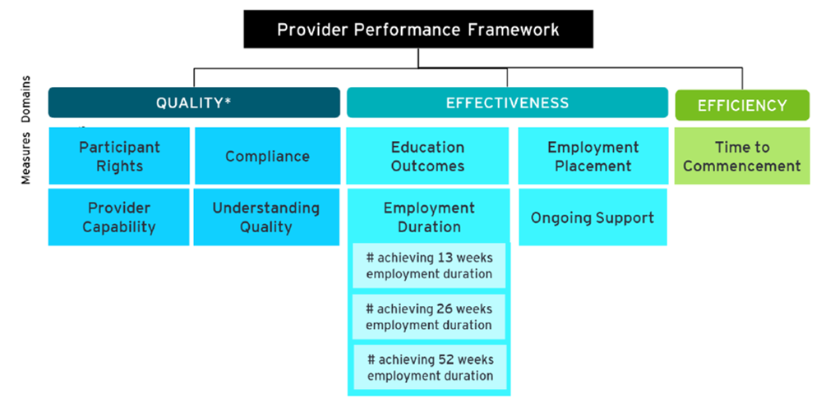
New Performance Framework
The new Performance Framework replaces the 2018 DES Performance Framework, Interim Measures and Star Ratings.
It monitors and measures the performance of providers against an agreed set of key performance measures to continuously improve the overall performance of the program in achieving meaningful and sustainable employment outcomes for participants.
The Framework uses the three Key Performance Indicators, consistent with the current DES Grant Agreement:

Slide 9
Provider Scorecard
PERFORMANCE SCORECARD
Provider:
Provider 3
Employment Service Area:
Kiewa
Detailed performance scorecards will be prepared for providers quarterly and include:
A rating for each individual performance indicator and an overall score for that Key Performance Indicator (Quality, Effectiveness or Efficiency)
A breakdown of the measures within each KPI, with a score against each.
First run of provider Scorecards produced for all providers late July 2024.
Due to availability of historical data, the first run of the Scorecards will include:
Employment Duration
Ongoing Support and
Quality (indicative) metrics only
Service Type:
ESS/DMS
Specialisation:
Specialist – Sensory impairment
Overview
This Performance Scorecard assesses providers against the DES Performance Framework domains of Quality, Effectiveness and Efficiency.
Provider 3 received a score of 2 out of 3 for Quality, 2 out of 3 for Effectiveness and 1 out of 3 for Efficiency.
QUALITY
Measures/Indicators
Score
Domain score
Participant Rights*
Meets expectations
2/3
Understanding Quality
Meets expectations
Provider Capability*
Meets expectations
Compliance
Meets expectations
EFFECTIVENESS
Education Outcomes
Improvement required
2/3
Employment Placement
Improvement required
Employment Duration
13 week
Meets expectations
26 week
Meets expectations
52 week
Exceeds expectations
Ongoing Support
Exceeds expectations
EFFICIENCY
1/3
Time to Commencement
Improvement required
What does each score mean?
Improvement required: Providers have not fully met service expectations and improvement actions are required
Meets expectations: Providers are meeting service expectations
Exceeds expectations: Providers are exceeding service expectations
*Quality metrics are only regarded as meets expectations or not

Slide 10
Participant Scorecard
PERFORMANCE SCORECARD
Provider:
Provider 3
Employment Service Area:
Kiewa
A higher-level scorecard will be made available for Participant use:
Assisting the participant to make an informed decision when selecting a provider
Highlights the name and location of the provider and the reporting period covered
The intention is to add any specialisation undertaken by that provider
Includes a brief description of each Performance indicator and the scoring metrics
First limited release of these scorecards published 24 August 2024
User testing will be undertaken prior to the publication of the scorecards to ensure the language is fit for purpose for participants
Service Type:
ESS/DMS
Specialisation:
Specialist – Sensory impairment
Overview
This Performance Scorecard assesses the performance of your provider against Quality, Effectiveness and Efficiency measures.**
Provider 3 received a score of:
2 out of 3 for Quality, meaning your service provider met service expectations*
2 out of 3 for Effectiveness, meaning your service provider met service expectations*
1 out of 3 for Efficiency, meaning your service provider has not fully met service expectations*
QUALITY
EFFECTIVENESS
EFFICIENCY
Quality of services provided to people with disability
Ability of providers to help people with disability complete education and find jobs
Time taken for people with disability to start in the program
What does each score mean?
Improvement required: Providers have not fully met service expectations and improvement actions are required*
Meets expectations: Providers are meeting service expectations*
Exceeds expectations: Providers are exceeding service expectations*
*Expectations are outlined in the DES Grant Agreement
** An additional explainer document will be provided with further information

Slide 11
Supported Employment
Supported employment measures announced in the 2023-24 Budget underway:
The Structural Adjustment Fund;
a new disability employment advocacy and information supports program; and
piloting employment expos.
Survey regarding transition to the Supported Wage System (SWS).

Slide 12
Feedback and more information
New information will be made available through the Department of Social Services (dss.gov.au/new-specialist-disability-employment-program) and DSS Engage <engage.dss.gov.au>
Email: DESConsultations@dss.gov.au

Slide 13
Questions

